Slide 1
Guidance for Leaders
Addressing MESH and Abuse Incidents with Youth
Great Falls Council
From SYT & Related Training

Slide 2
Background
MESH (Mental, Emotional & Social Health) and Youth-on-Youth Abuse incidents comprised >23% of the total incidents from 2023-2025 within the GFC and therefore deserve serious attention.
  Mental Health is how we think, feel, and act, especially when experiencing stressors. Emotional Health is our ability to manage and express feelings to others. Social Health is our ability to interact and form meaningful relationships.
  Scouting MESH is a Scouting America initiative designed to address growing mental health challenges by equipping leaders and camp staff with skills to support youth mental wellness, manage stressors, and build resilience. MESH focuses on building a safe, supportive community where youth can thrive emotionally and socially while experiencing the adventure of Scouting, and to help adults recognize, support, and respond to mental health issues.
  Youth-on-Youth abuse is a contributor to MESH issues and must be actively prevented and addressed.
Our unit leaders need to be equipped with how to recognize and mitigate these issues, as well as how to effectively deal with them when they do occur. It is not their responsibility to diagnose serious issues, but to help the individual get professional help.
New training provides excellent guidance and has been summarized in into this concise guide for leaders to review and refresh periodically so they’re prepared, as well as to refer to if a situation occurs.
Scouting can be a great antidote with positive role models and helping youth to grow strong emotionally through challenges!

Slide 3
Outline
Recognize Behavioral Issues
How to Prevent & Mitigate Issues
How to Respond to the Youth
Hurdles to Disclosure by Youths
Reporting
Barriers to Abuse Summary
Summer Camp Specifics

Slide 4

Recognize
Bullying:
  What to look for: injuries, damaged personal items, troubled/changed sleep/eating habits, headaches, stomachaches, self-destructive tendencies (running away, mood swings, abrupt changes in friends, falling grades, avoiding participation). Keep an eye out for lowered self-esteem, self-blame, fearful of defending themselves. Look for imbalance of dynamics between youths
  How to Identify: Might get into fights a lot, be aggressive, blame others, need constant discipline/supervision. A scout who feels that their opinion is THE opinion, none other count. Ego-centrism is a problem. Must take action to make the playing field more level so all scouts have an opportunity to be a leader.
2. Sexual Abuse:
  How to Recognize: No guaranteed formula – all children are different. Common signs: Abrupt behavioral changes. Avoiding another scout, asking to change rooms or go home. Major emotional reaction to a minor event. Frequent/ inappropriate touching. Dominant/bullying behavior. Secretiveness. Vague physical complaints. Listen to your instincts if something tells you it’s not right.
  Youth on Youth: Red - Abusive and violent. Initiation & games. Non-consensual acts, coercive behavior, use of physical force, sharing inappropriate images, sexual talk, use of AI to produce harmful images.
3. On-Line Threats:
  Keep an eye out for dramatic changes in emotion, behavior and deviations from the norm for that child. Kids don’t usually ask for help.

Slide 5
How to Prevent & Mitigate
1. Bullying:
  How to Prevent: Teach scouts to be leaders in this space. Make it be seen as negative behavior, so it’s viewed poorly. The goal is to build Cohesion, Respect, Loyalty and Leadership.
  Bully’s think that they will gain respect by being a bully, when they actually just gain fear, which is not respect. Bullying may be common in a child’s background. They will need to be “re-programmed” and re-wired. E.g., explain why you chose to solve a problem in a way that didn’t include putting someone down, speaking negatively about them, etc.
  Pave a new path! Scouting is about working together, not about standing on top of someone else. The goal is to help someone be the best, so you can bring that other younger child up so that all are at an equal level.
  Spot It. Stop It. Show the way. Demonstrate through your actions.
2. Sexual Abuse:
  Follow the barriers to abuse – make sure they’re implemented!
  Be aware; recognize the signs!
  Adult grooming behaviors are hard to spot because they don’t appear illegal. You can question actions in a not threatening way. E.g., “I think that what you are doing is a violation of Youth Protection Policies and we will need to find another way to accomplish this.”
  Youth-on-Youth: Adult supervision, communication and monitoring are key to prevent this.
  Anonymous texts by Scouts to the Scout help line. @1-844-SCOUTS 1. Hope this is a deterrent to anyone who is looking to abuse a youth.

Slide 6
How to Prevent & Mitigate
3. Online Threats:
  Empowering education is key. Keep communication open – talk regularly about staying safe online. Ask if they’ve talked to anyone about feeling weird and if they know how to block them. Make sure they know the red flags – they should know the full name, phone number and real-life details. Make sure they understand the platform and if a game allows messages with strangers – this is a real risk. Tell them to be respectful – to treat others online as they would in person. Avoid getting involved in arguments. Don’t gang up on others.
  A casual check-in, one-liner, “Hey you guys – if you ever encounter any problems, we’re here for you.” Can open the door to conversation. Good in a car ride too. They may come back later – they may need time to process before they’re ready to open up.
  Resource for more information: www.NCMEC.org
  Scouting also partners with law enforcement through the “Know2Protect” by DHS. “Know who’s on the other side” to stop online child exploitation. Focus on empowerment not fear. Agents will come and talk to your troops. Tipline: 833-591-KNOW.

Slide 7
How to Respond to Youth:
1. The Bully
  Zero Tolerance. Avoid using labels, assume it will resolve on its own or force apologies in a group setting. Stay calm, stop the behavior, separate the youth involved, make sure all are safe, address any needs (physical or mental), call for assistance if needed. Identify by-standers and discuss separately/ privately. Stay impartial! Notify program leadership about the incident. How you respond can have an impact on all involved. Need a plan on how to redirect the child.
  Confront and Correct: Tell a Scout who’s starting to demonstrate bullying behaviors that that’s not how we have teamwork. Be very specific! Name the behavior. Remove the child from the position of power to where another child is displaying appropriate leadership. If the child cannot adjust their behavior after numerous corrections, they cannot have an appropriate space in Scouting.
  Face It/ Fix It. Don’t brush it off or assume they’ll get over it. The role of Scouting is to encourage teamwork and good leadership.

Slide 8
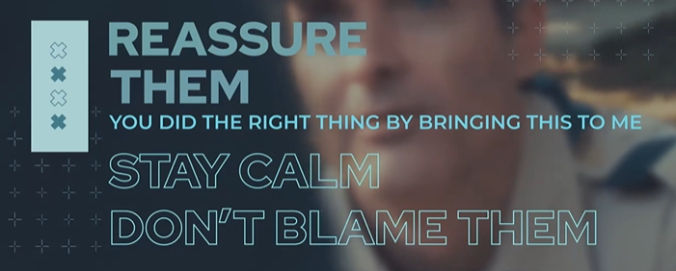
How to Respond to Youth:
2. The Mistreated Youth:
  It’s uncomfortable, but your response to a child’s first disclosure is very important and can have lasting effects. They might not begin with a clear or complete account. An initial disclosure may seem unrelated and insignificant. Must actively listen to recognize small disclosures as cries for help. Understand what to look for and how to respond.
  But leaders do not need to be investigators – they are smoke detectors, not the fire hydrant.
  Make sure they know that there’s always an adult to help. Supportive language, “I’m glad you asked for help” and “We’ll figure this out”. Not – “You shouldn’t have…” which is victim blaming and can discourage opening up.
3. Online Threats on a Youth:
  Don’t yell
  Guide them – instruct them to stop the communication with the predator
  Document it – take screenshots of any relevant images or messages
  Don’t pay or send money
  Block the offender on all platforms

Slide 9
Responding to Youth in General:
If a Scout is brave enough to come to you, here’s how you respond. The first few moments are crucial for them to know that they will be heard. Be the adult and keep calm.
  Take a deep breath
  Be in a listening pose. Make sure child feels comfortable.
  Start with belief. It’s unlikely that they’re lying.
  Just listen. Don’t plan or think of what your response will be.
  Reassure the child that coming forward is the right thing to do, and that you know the next steps.
  A calm and confident demeaner will make them feel safe.
  Write down what you heard. Document as soon as possible what you heard.
  Be discreet. Don’t share the information widely. Only those that need to know.

Slide 10
Hurdles to Disclosure by Youths
Disclosing abuse is incredibly difficult for a child. There are many reasons why a young person may hesitate to speak up, even when they’re in a safe environment.
What hinders children from coming forward:
  Fear of retaliation (physical or mental threats)
  The burden of shame (they often blame themselves; perpetrators prey on this)
  Social stigma associated with making statements and being judged/labeled as damaged or trouble-maker.
  Often the abuser is someone in the family or known by the family, and that is a barrier to disclosure.
  Need to protect friendships/peers
  Fear of not being believed (could result in further isolation)
  Worry about confidentiality. They don’t want others to know; don’t understand how confidentiality works.
  Fear of the aftermath. What is the next step. Will their troop get shut down, will they still get to see their friends, what happens to the abuser. Uncertainty paralyzes action.
  A sense of betrayal by the perpetrator. The fact that person they trusted did this, can outweigh the actual abuse and silence them.
  Government involvement – Fearful of the legal fallout and potential Child Protective Services – the uncertainty of what will happen to *them* causes inaction.

Slide 11
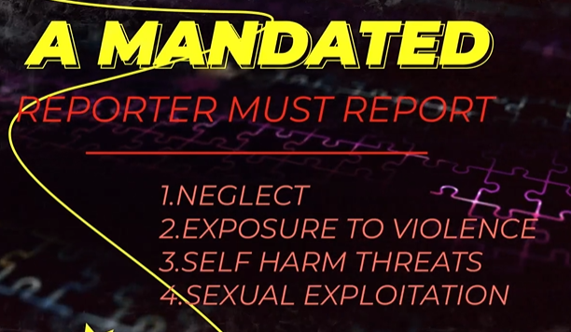
Report
Adult volunteers are mandated reporters - you are required to report any neglect or abuse that you see. Includes any statements or behaviors or violations of safeguarding policies that you’ve seen. You are not determining guilt.
How to Report:
  Ensure Scout is in a safe environment
  If there’s injury, call 911 immediately
  If in the Scout’s home or family, you are required to call the local child abuse hotline
  Notify the SE, or email Scoutfirst@scouting.org, or call 24 hr hotline: 844-726-8871 (844-SCOUTS1)
  Can also text the number anonymously!
  Reporting requirements varies from state to state. Refer to www.childwelfare.gov the gateway to a variety of topics and state info
  Follow-up services to the youth and family will be offered by Scouting America

Slide 12
Barriers to Abuse Summary
Core Prevention & Policies
Barriers to Abuse: Scouting rules strictly prohibit one-on-one contact between youth and adults, and mandate the buddy system at all times to prevent isolated incidents among peers. Appropriate accommodations and privacy guidelines are also important to follow and maintain.
Mandatory Reporting: Any suspected case of abuse or harassment must be immediately reported to local law enforcement, followed by a notification to the local Scout executive.
Volunteer Screening Database: A comprehensive database to track and permanently remove individuals who have engaged in inappropriate or abusive behavior.
Youth & Leader Training
Personal Safety Awareness Series: These mandatory videos are integrated into rank advancements to teach Scouts how to identify safe/unsafe situations and address bullying.
Youth-on-Youth Training: Specialized guides and training modules are provided to unit leaders and camp staff to help them recognize warning signs, handle misconduct, and intervene immediately.
How to Report & Get Support
ScoutsFirst Helpline: If you are dealing with a dangerous situation, witnessing policy violations, or suspecting abuse, contact the 24/7 Scouts First Helpline by calling 1-844-SCOUTS1 (1-844-726-8871) or emailing scouts1st@scouting.org.
Counseling Support: The helpline also offers counseling and assistance to any current or former youth members and their families who have been affected by abuse.
Summer Camp Considerations
Incident numbers often rise as camp progresses
Leaders should not feel that they can take a backseat, leaving discipline to the Scouts or the camp staff.
Do not turn a blind eye to pranks/vandalism – they can include an element of youth-on-youth abuse.
Cannot adopt a “That’s just kids being kids” attitude. Address any bullying or harassing behavior.
The staff should identify activities that can cause high stress and have alternatives for the Scouts.

Slide 13
Summer Camp Specifics for MESH
Summer camp can be stressful for Scouts, camp staff, and adult leaders - this can affect the person’s mental health. Think about how you felt the first summer you went to camp for a week - it was a new experience and different from what you’re used to.
Providing support can make the difference between a difficult versus a positive camp experience. There are some proactive things to help improve the outcome:
Make sure parents have all necessary information before camp so their child can have a successful camp experience. Encourage parents/guardians to contact camp leadership well before camp begins to discuss any mental health concerns.
If a youth is prescribed medications for mental health issues, discuss the medication plan with parents and unit adult leaders before camp begins if possible. Ideally, this would include adult unit leadership, the Camp Health Officer, and camp leadership as needed.
Encourage youth to watch out for other youth; all must be willing to tell adults what they see and hear – not to just be a bystander.
Encourage all to be mindful of themselves – to make sure they are taking care of themself, so they feel good:
  Have a good diet. Junk food can make you feel unwell.
  Stay hydrated! Dehydration can cause headaches and grumpiness.
  Sleep. You’re not at your best if you’re tired.
  Rest. Take a break and relax quietly to re-charge.
  Do something just for you – something you like that brings joy.
  Take time off over the summer and don’t over-schedule yourself.
  Connect with others. New friends and relationships enhance your life.
  Have fun! Be “present” and enjoy where you are.

