Slide 1
Scouting BSA
Great Falls Council
Incident Reporting Training
October 2024
Presentation in Standard slide size to enable printing

Slide 2
Why Reporting is Important
We need to be proactive in preventing future problems!
Information from incident and near miss reports can be used to identify risks, root causes and ways to fix them.
The reports create support for needed changes and initiative to address problems.
It helps promote a culture of safety.
It’s one of the ways to live the Scout Oath and Law.
Adults should set an example on how to address safety concerns.
A good safety track record can result in reduced insurance rates which means more funds can be available for scouting activities.
The report enables insurance claims.
It’s how we support National’s initiative to increase reporting.
Reporting is not for assignment of blame; rather, a positive recognition for helping to prevent problems.

Slide 3
Why Reporting is Important
Continuous Improvement
We improve is by identifying what needs to be fixed and working on it.
Compiling information related to incidents and near misses gives councils information with which to better understand risks
Identification and communication of new risks enable opportunities for continuous improvement across the council
Everyone in Scouting can help by offering suggestions, and by reporting Incidents and Near-Misses
This is how we help to prevent potential injuries and damage in the future!
Training is another way by which we can continually improve.
From myBSA:
  Timely and complete incident reporting provides BSA with an opportunity for analysis of incidents that occur and promotes continuous improvement of our programs.
  The sooner a clear, concise, and complete incident report is made, the sooner an appropriate response to the incident can occur.
Help Identify Risks and Fix Them!
Let’s look out for each other and not have any regrets that we didn’t speak up!

Slide 4
To Encourage Reporting:
Requesting that District Newsletters have a section on Incident and Near Miss reporting
This will give leadership an opportunity to thank Districts and Units for supporting the national initiative
More importantly, this open communication also serves as:
  Reminders to other Districts and Units about the need to submit reports
  Education and awareness across the council on risks that were identified, and how they were addressed
  An opportunity to prevent problems in other areas through the learning obtained and communicated

Slide 5
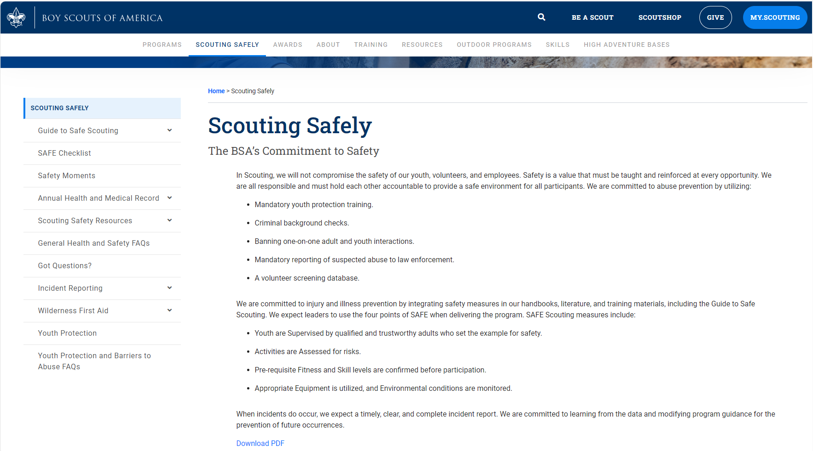
Reporting Link Location
Anyone can submit a report – it is very quick and easy
Navigate to www.souting.org. Select “Scouting Safely” from top menu, then “Incident Reporting” from left side menu

Slide 6
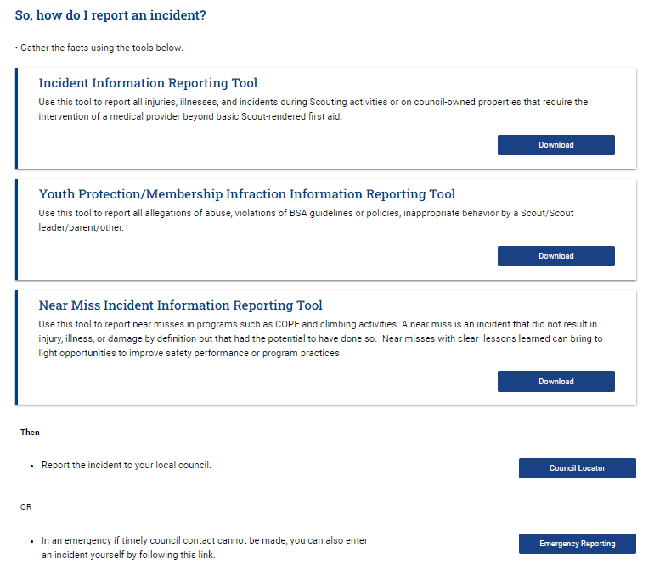
Reporting Link: Incident Reporting
Who & How: Anyone can submit a report – it is very quick and easy
Preserve and document evidence and take photos if appropriate.
Submission Options:
Download the appropriate form.
  Print, fill in and mail it to your local council. (“Council Locator” tool provides mail address)
  Fill in electronically and email it to the Scout Executive
  Use the form as a tool to collect information prior to entering information directly into the system.
Create and fill in new case at “Emergency Reporting” link. This can also be used for non-emergencies.
  riskonnectbsa.my.salesforce-sites.com

Slide 7
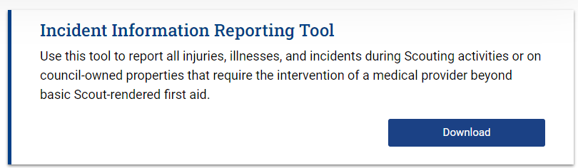
Incident Reporting
What is an Incident
  An event – at any location where Scouting activities occur - that causes injury, illness, or property damage during Scouting activities or on council-owned properties that requires the intervention of a medical provider beyond basic Scout-rendered first aid.
  Applies to all Scouting activities, including transportation to and from an event.
When to report (Reporting requirements: 680-151 Incident Reporting Requirements.pdf)
  SERIOUS INCIDENTS – Immediately call 911 and/or law enforcement and notification to Scout Executive (who will enter into Riskonnect within 24 hours). You can also contact the Scouts First Helpline: 1-844-SCOUTS1.
    Fatalities
    Sexual or physical abuse
    Potentially life-threatening injuries (e.g., amputation, brain injury, loss of sight, paralysis, etc.)
    Those requiring air transportation or medivac
    Communicable disease (e.g., measles, norovirus, etc.)
    Significant damage to property (e.g., wildfire, tornado, hurricane, etc.)
    Any for which media attention is anticipated
  LESS-SERIOUS INCIDENTS - Complete incident entry into Riskonnect within 72 hours (3 days), and notify the Scout Executive
    Treatment beyond Scout-rendered first aid
    When a licensed health care official provides medical attention at the health lodge
    Intervention of emergency response personnel
    Those requiring a visit to a licensed health care provider
    COVID exposures and positive test results
  OCCUPATIONAL INJURY REPORTING
    All work-related injuries of National Council staff must be reported as a workers’ compensation claim.
    All employers are required to notify OSHA when an employee is killed on the job or suffers a work-related hospitalization, amputation, or the loss of an eye. An in-patient hospitalization, amputation, or eye loss must be reported within 24 hours. Fatalities must be reported within 8 hours.

Slide 8
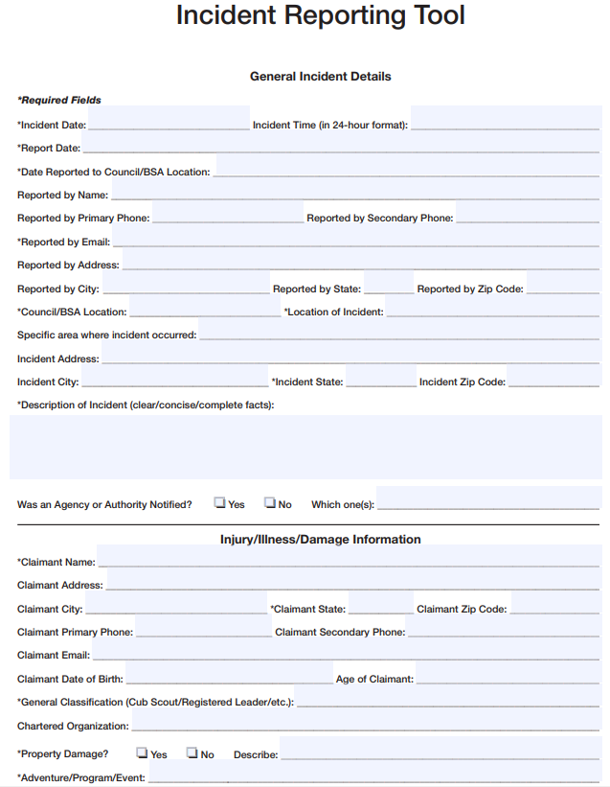
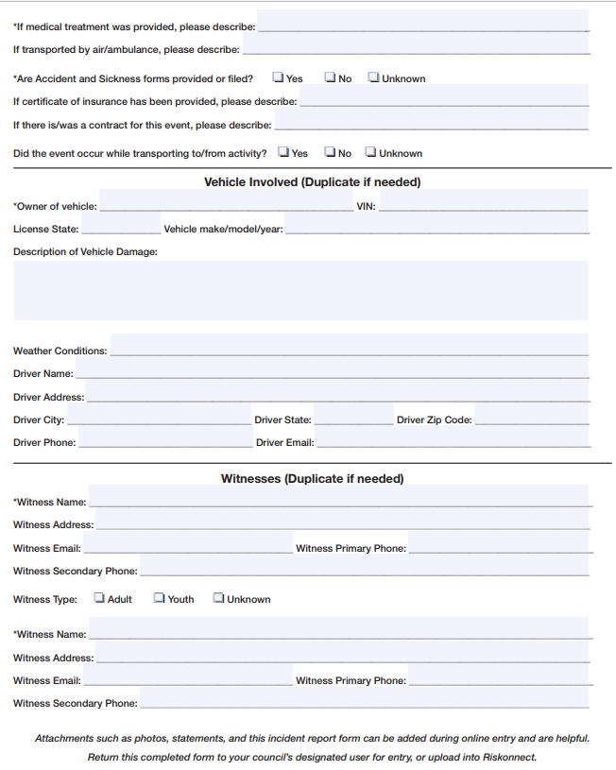
Incident Reporting Form on National Site
Fill in and mail, or use to collect information prior to entering it into the system

Slide 9
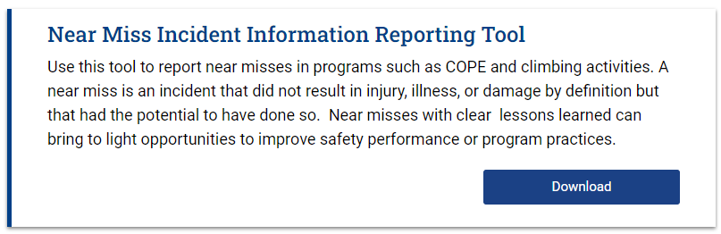
Near Miss Reporting
COPE: Challenging Outdoor Personal Experience
What is a Near Miss
  An event – at any location where Scouting activities occur – that did not result in injury, illness or damage (beyond Scout-rendered first aid) but, under slightly different circumstances, had the potential to do so.
  If you think, “Ooh, that was close!”, it was a Near Miss.
  If you see a risk that could cause an incident and hasn’t been addressed, it’s a Near Miss.
  In general, if something could have been much worse, it’s a Near Miss. It’s an opportunity to fix something to avoid a future incident.
  Apply common sense and take the time to submit a report to help prevent future injuries. Avoid wishing that you had!
  Example: Tripping over debris in the axe yard and get scrapes.
  Getting scratched by thorns while hiking is not a Near Miss, even though it might need Scout-rendered first aid.
  When to report (Reporting requirements: 680-151 Incident Reporting Requirements.pdf)
    Complete incident entry into Riskonnect / Emergency Reporting link within 72 hours (3 days), and notify the Scout Executive

Slide 10
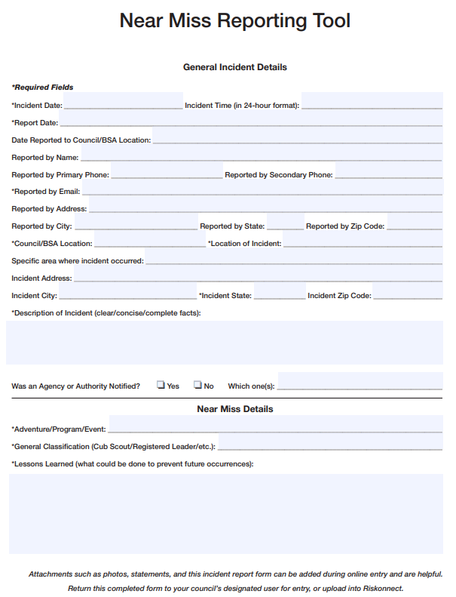
Near Miss Reporting Form on National Site
Fill in and mail, or use to collect information prior to entering it into the system
Form only requires the name of the submitter. This is needed for potential questions and follow-up.
Under “Description of Incident”, please just describe what happened.

Slide 11
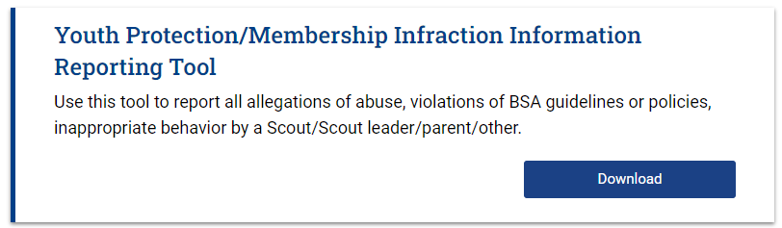
Youth Protection Infraction Reporting
What is a Youth Protection Infraction:
  Any occurrence of abuse, violations of BSA policies and/or YP guidelines*, inappropriate behavior by a Scout/ Scout leader/ parent/ other at any location where Scouting activities occur.
  * http://usscouts.org/safety/YP_guidelines.pdf
  When to report (Reporting requirements: 680-151 Incident Reporting Requirements.pdf)
  Sexual or physical abuse is a “Serious Incident” and must be reported immediately
    Mandatory for any occurrence of abuse.
    Any incident of child abuse must first be reported to local law enforcement or child protective services. Also notify the Scout Executive the Scouts First Helpline at 1-844-SCOUTS1 (1-844-726-8871).
  Less Serious Incidents: Contact the Scott Executive to discuss incident (who will make entry into Riskonnect within 72 hrs).
    Code of Conduct violations
    Threats or acts of violence
    Arrest for a crime that, if convicted, would disqualify the individual from participation in Scouting (e.g., listing on sex-offender registry, etc.)
    Situations in which a member, leader, parent, or volunteer is required to cease participation pending an investigation.

Slide 12
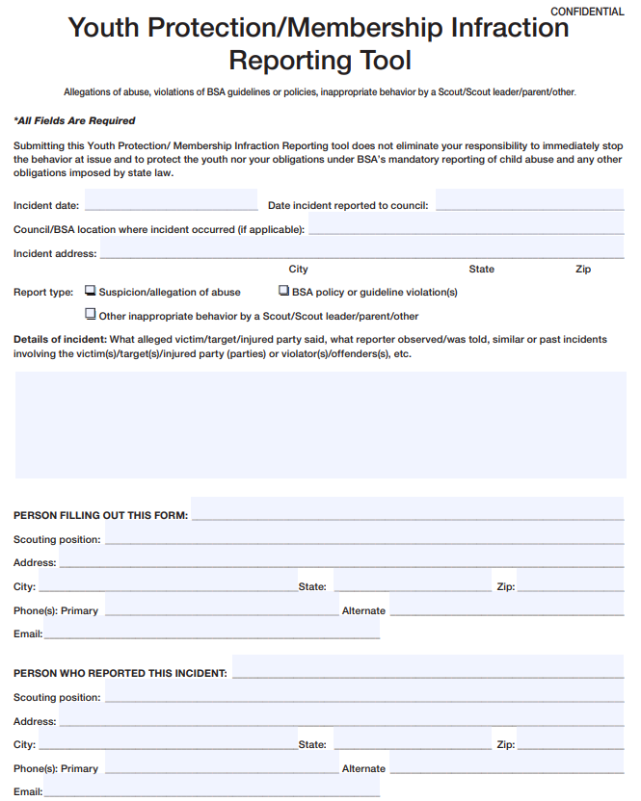
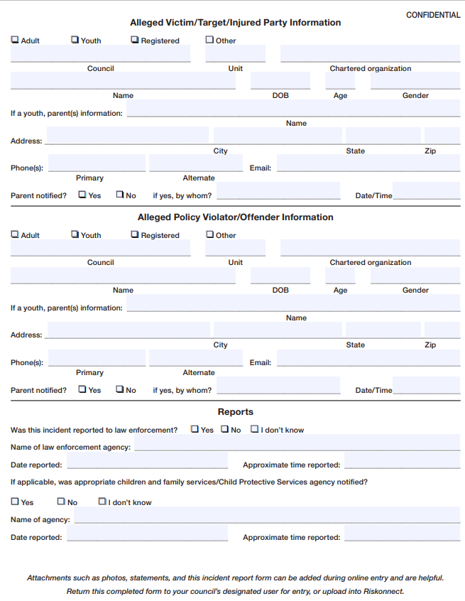
Incident Reporting Form on National Site
Fill in and mail, or use to collect information prior to entering it into the system

Slide 13
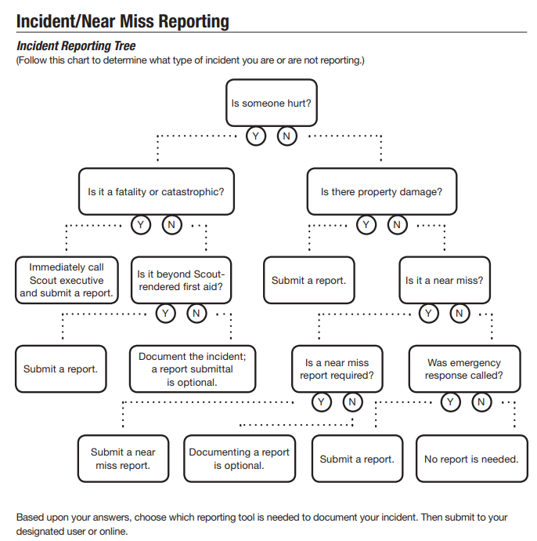
Incident Reporting Flowchart
Use to determine what type of report to file
Incident/Near Miss Reporting Flowchart: Incident-Reporting-Infographic.pdf (scouting.org)
Start at the top and answer each question until you reach a point where a report is recommended or not.
  For the Great Falls Council, if an event is a Near Miss, it should be reported.

Slide 14
A Word on How We Prevent Problems
First - be vigilant and proactive in knowing and minimizing risks when planning activities
“A Scout is never taken by surprise; he knows exactly what to do when anything unexpected happens.”
-Robert Baden-Powell
Go to the Guide to Safe Scouting and review requirements for the specific activity being planned
Search Safety Moments to find the appropriate topic; review and make sure risks are addressed before starting an activity
Review the SAFE Checklist and supplemental documents* for compliance before starting an activity (*Project Planning; Tool/Equipment Use; Transportation)
  Supervision – qualified and trustworthy adult responsible for well-being of youths
  Assessment – of risks during planning, prior to activities.
    Also know what to do if the risk does happen so you’re not trying to figure it out when time is critical
  Fitness & Skills – confirm physical/mental ability & skills prior to participation.
    Appropriate training is required prior to participation
  Equipment & Environment – ensure all conditions (equipment, sites, terrain, weather, clothing) are: in good repair; appropriately fitted/suitable; used properly; assessed for hazards; and, monitored for participant safety.
Reflect on “PAUSE” just prior to starting an activity.
  Pause before you start
  Assess possible hazards
  Understand how to proceed safely
  Share your plan with other
  Execute the activity safely

